Slide 1

BASICS OF STREAMLIT
HARITHA P V
MST03-0058

Slide 2
CONTENT
INTRODUCTION TO STREAMLIT
USE CASE
KEY FEATURES
STREAMLIT INSTALLATION
LAUNCHING A STREAMLIT APP
STREAMLIT ARCHITECHTURE

Slide 3

INTRODUCTION TO STREAMLIT
Streamlit is an open-source framework for building and deploying data apps quickly.
Simplifies the process of creating interactive web applications for data science and machine learning projects.
Streamlit apps update in real-time, perfect for quick prototyping and data sharing.

Slide 4

USE CASES
Data Visualization: Build interactive dashboards for analyzing datasets.
ML Prototyping: Rapidly prototype and showcase machine learning models.
Data-driven Apps: Create applications like recommendation systems and financial calculators or any app.

Slide 5
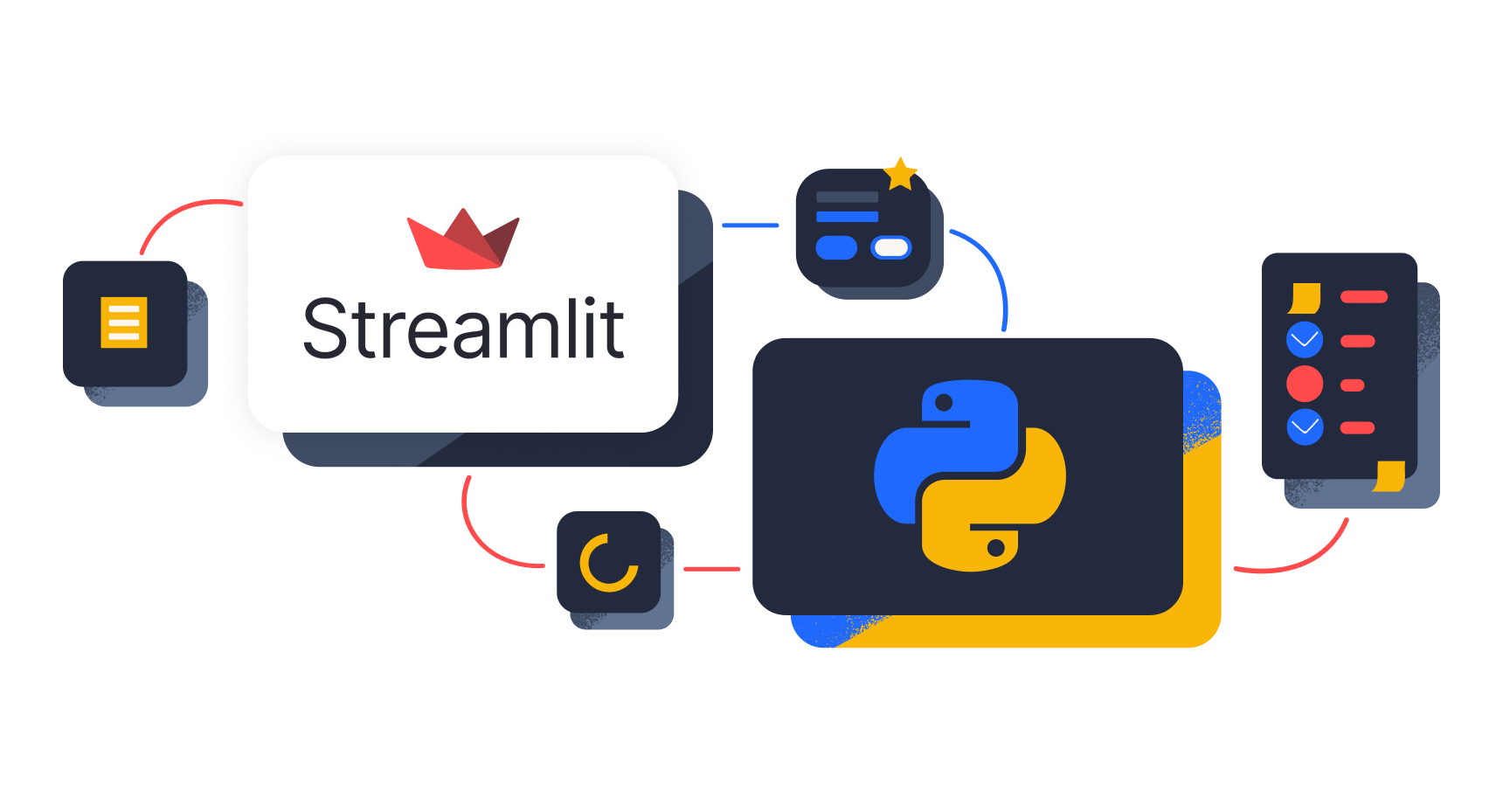
KEY FEATURES
Simple API: Easily create interactive elements with familiar Python syntax.
Live Updates: See real-time changes as you edit your code.
Widgets & Components: Customize interfaces with built-in widgets and tools.
Easy Deployment: Quickly deploy apps to platforms.
Active Community: Benefit from a growing ecosystem and vibrant user base.

Slide 6
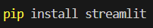
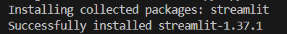
STREAMLIT INSTALLATION
STEP 1
Open the command prompt/terminal.
STEP 2
Install streamlit.

Slide 7
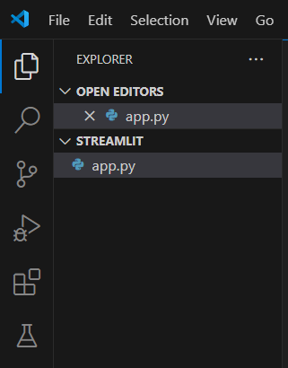
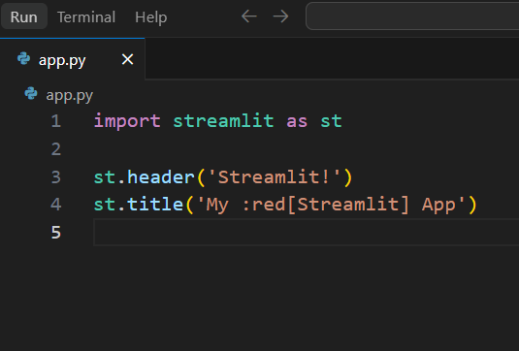
LAUNCHING A STREAMLIT APP
STEP 1
Create a python script file.
STEP 2
Import streamlit in python file.
Add the app code.

Slide 8
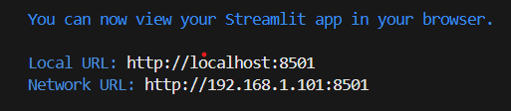
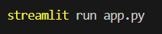
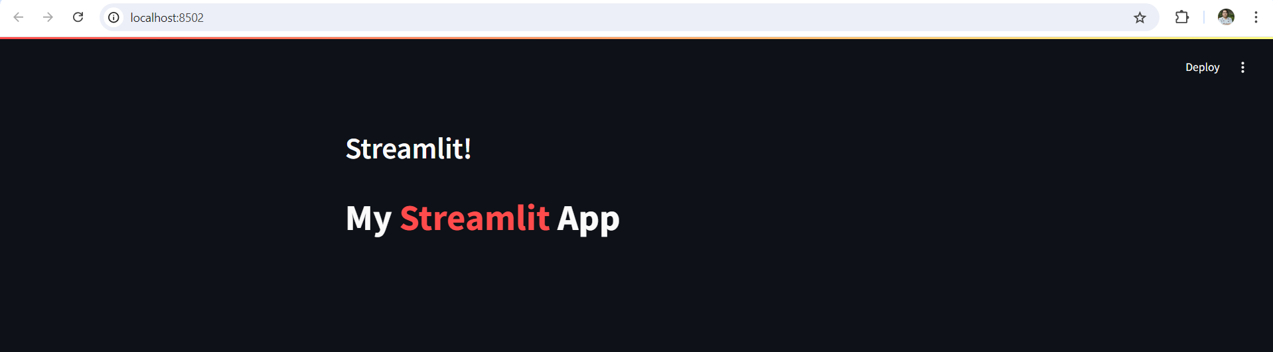
STEP 3
Launch your streamlit app.
Streamlit app on localhost.

Slide 9
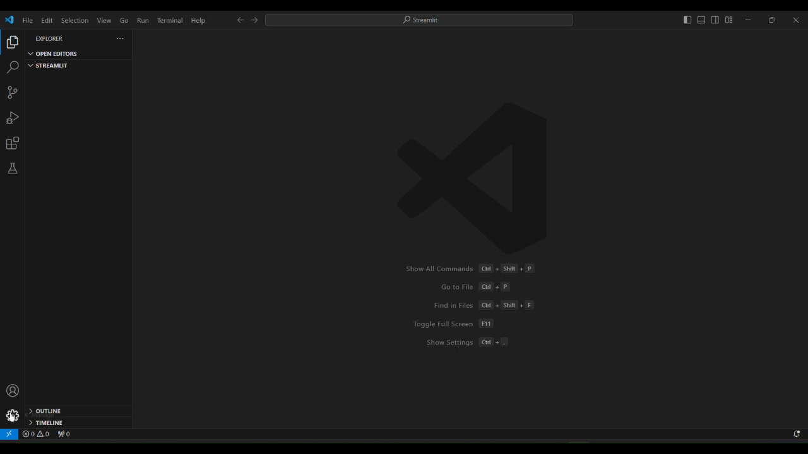
INSTALLATION AND LAUNCH OF STREAMLIT APP (VIDEO GUIDE)

Slide 10
STREAMLIT ARCHITECTURE
📝 Write Python Code
⬇️
🔄 Streamlit (Processes the Code)
⬇️
⚙️ Back-End (Server side)
⬇️
👁️‍🗨️ Front-End (Client side)
⬇️
👨‍💻 User Interactions
Write Python Code: Define the app's functionality and interface in a Python script.
Streamlit (Processes the Code): Streamlit processes the code to set up the app.
Back-End (Server side): Handles data processing and logic behind the scenes.
Front-End (Client side): The user interface is displayed in the web browser.
User Interactions (Via the Web App): Users interact with the app, and these interactions are handled by the server.

Slide 11
SUMMARY
Streamlit is a Python framework for building interactive web apps quickly.
Ideal for creating data-driven applications and visualizations with minimal code.
Installing streamlit with ‘pip’ and start building with a simple Python script.
Streamlit allows real-time updates and easy deployment, enhancing rapid prototyping and data sharing.

Slide 12
THANKYOU

